Slide 1

CSE 473: Pattern Recognition

Slide 2
Linear Classifier: Introduction
Classifies linearly separable patterns
we know the proper forms for the discriminant functions
may not be optimal,
very simple to use

Slide 3
Linear discriminant functions and decisions surfaces
Definition
  Let a pattern vector x = {x₁, x₂, x₃, …,}
  a weight vector w = {w₁, w₂, w₃, …,}
  A discriminant function :
  g(x)=x₁w₁+x₂w₂+x₃w₃+…
  OR
  g(x) = w^{t}x + w₀ (1)
  where w is the weight vector and w₀ the bias

Slide 4
Linear discriminant functions and decisions surfaces
Classify a new pattern x as follows
Decide class ω₁ if g(x) > 0
and class ω₂ if g(x) < 0
If g(x) = 0 ⇒ x is assigned to either class

Slide 5
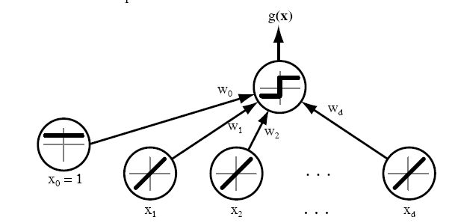
Linear discriminant functions and decisions surfaces

Slide 6
  The equation g(x) = 0 is the decision surface that separates patterns
  When g(x) is linear, the decision surface is a hyperplane

Slide 7
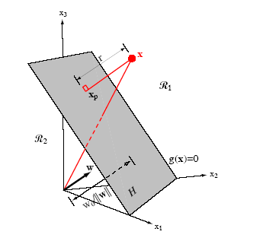

Slide 8
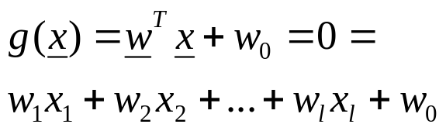
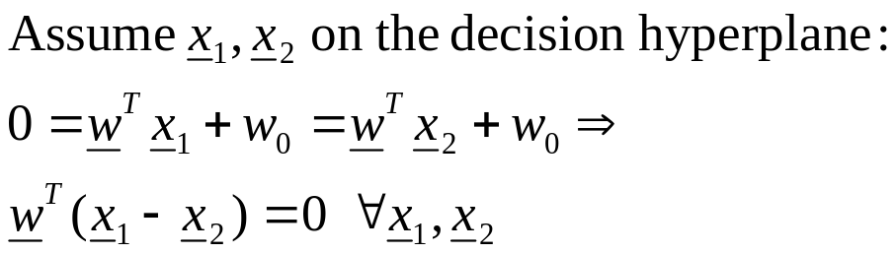
A little bit mathematics
The Problem: Consider a two class task with ω₁, ω₂

Slide 9

  Hence:

Slide 10
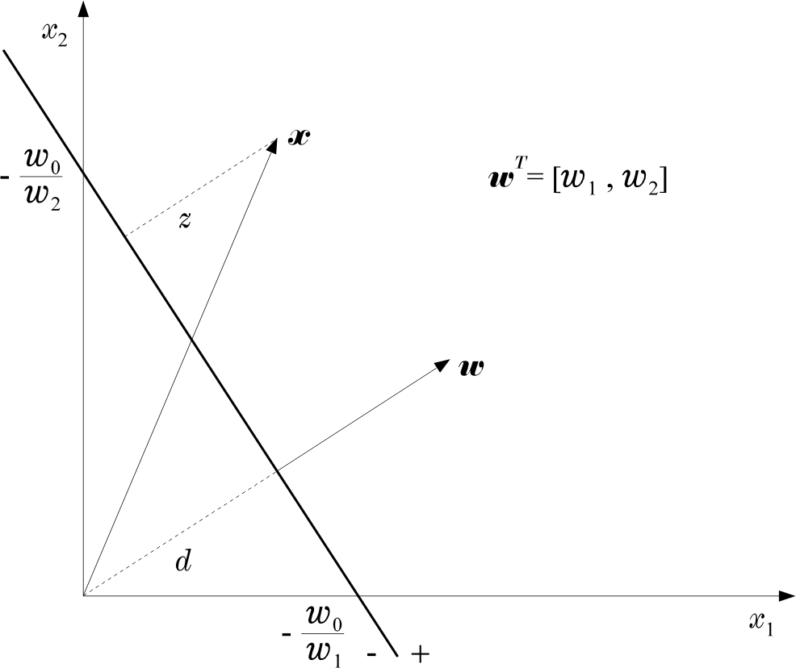
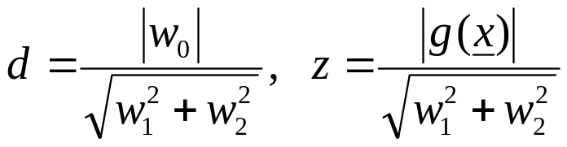
  Hence:

Slide 11
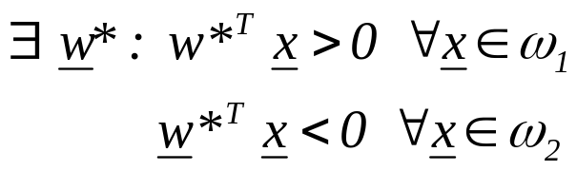
The Perceptron Algorithm
  Assume linearly separable classes, i.e.,

Slide 12
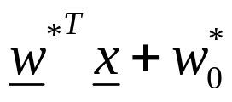
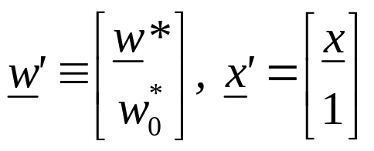
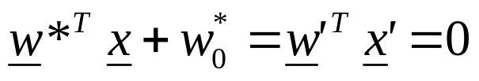
The Perceptron Algorithm
  Assume linearly separable classes, i.e.,
  The case
  falls under the above formulation, since

Slide 13
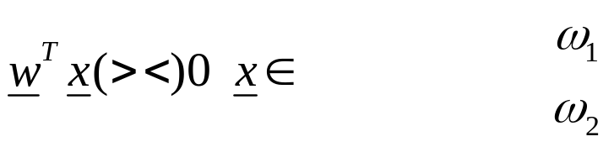
  Our goal: Compute a solution, i.e., a hyperplane w,
  so that
    The steps
      Define a cost function to be minimized
      Choose an algorithm to minimize the cost function
      The minimum corresponds to a solution

Slide 14
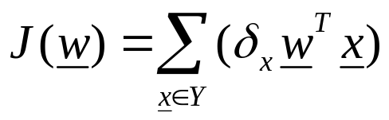
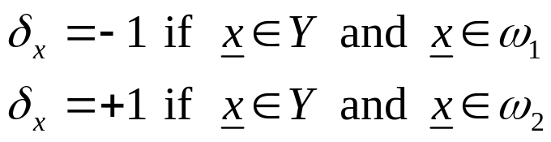
  The Cost Function
    Where Y is the subset of the vectors wrongly classified by w.

Slide 15
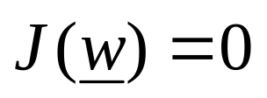
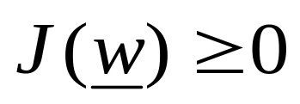
  The Cost Function
    Where Y is the subset of the vectors wrongly classified by w.
    when Y=(empty set) a solution is achieved and
    otherwise

Slide 16

    J(w) is piecewise linear (WHY?)
  The Algorithm
    The philosophy of the gradient descent is adopted.

Slide 17
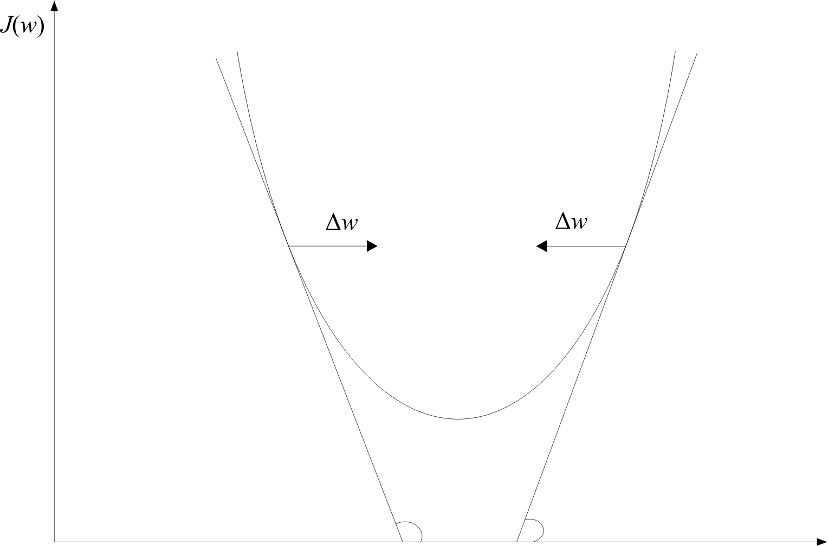
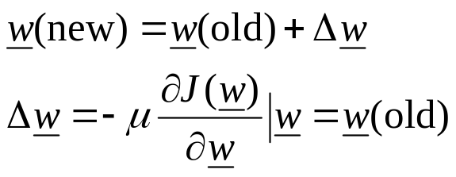
w

Slide 18
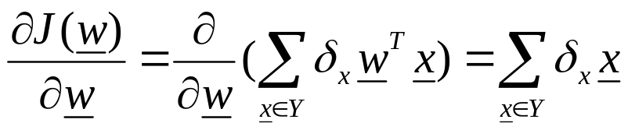
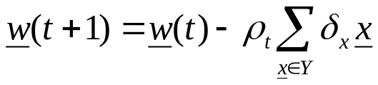
    Wherever valid
    This is the celebrated Perceptron Algorithm
w

Slide 19
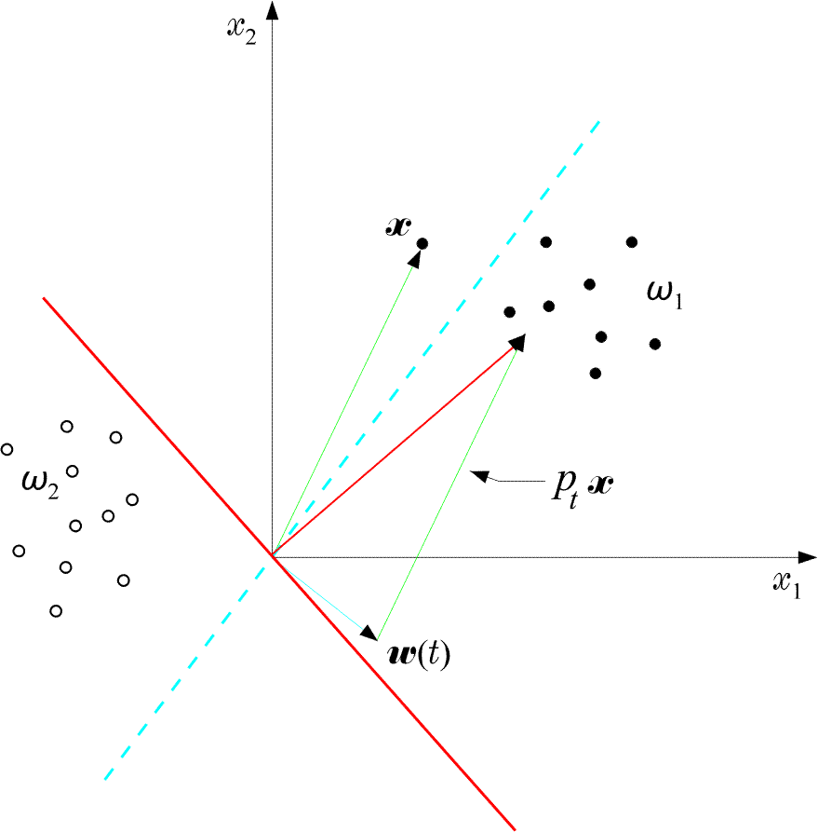
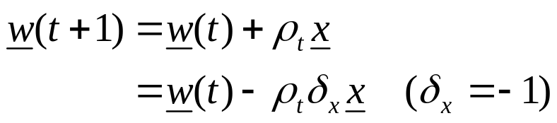
  An example:

Slide 20
  An example:
  The perceptron algorithm converges in a finite number of iteration steps to a solution if

Slide 21

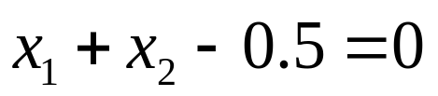
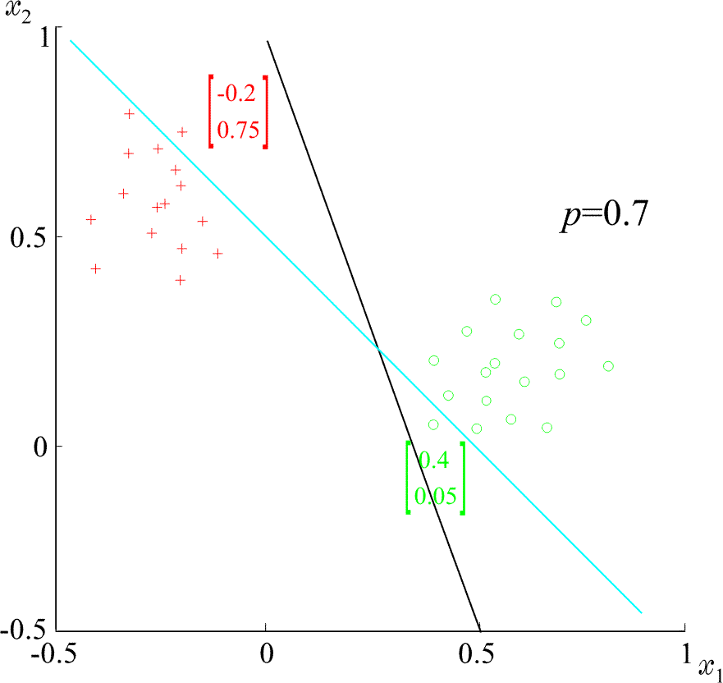
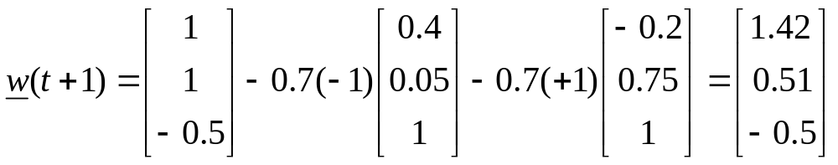
  Example: At some stage t the perceptron algorithm results in
  The corresponding hyperplane is
ρ=0.7

Slide 22
Convergence Proof of Perceptron Algorithm
Let , w* be the optimal weight vector
w(t) be the weight vector at the tth iteration
w(t+1) be the weight vector at the (t+1)th iteration
We will prove that ||w(t+1) - w* || < ||w(t) - w* ||

Slide 23

Convergence Proof of Perceptron Algorithm
We know that
Let , α be a positive real number
Then,

Slide 24


Convergence Proof of Perceptron Algorithm
Squaring both sides,

Slide 25



Convergence Proof of Perceptron Algorithm
However,
Hence,

Slide 26


Convergence Proof of Perceptron Algorithm
Now, define
and

Slide 27


Convergence Proof of Perceptron Algorithm
Now, define
and
Here, is always negative, so is γ
We can write,

Slide 28

Convergence Proof of Perceptron Algorithm
If we choose,
We can write,

Slide 29
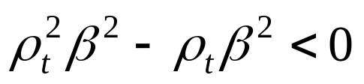
Convergence Proof of Perceptron Algorithm
Here,
How?

Slide 30



Convergence Proof of Perceptron Algorithm
Applying the above equation successively for steps t, t-1, . . ., 0, we get
However,
and

Slide 31
Convergence Proof of Perceptron Algorithm
However,
and
This means,
After some constant tine t₀ the R. H. S. will be non-positive
But, the L. H. S. cannot be negative
Therefore,

Slide 32

Convergence Proof of Perceptron Algorithm
is equivalent to

Slide 33
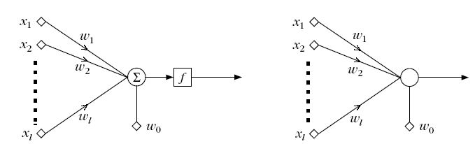
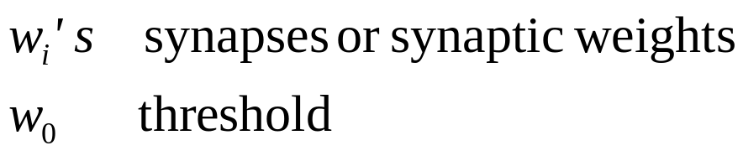
The Perceptron
The network is called perceptron or neuron
a learning machine that learns from the training vectors

Slide 34
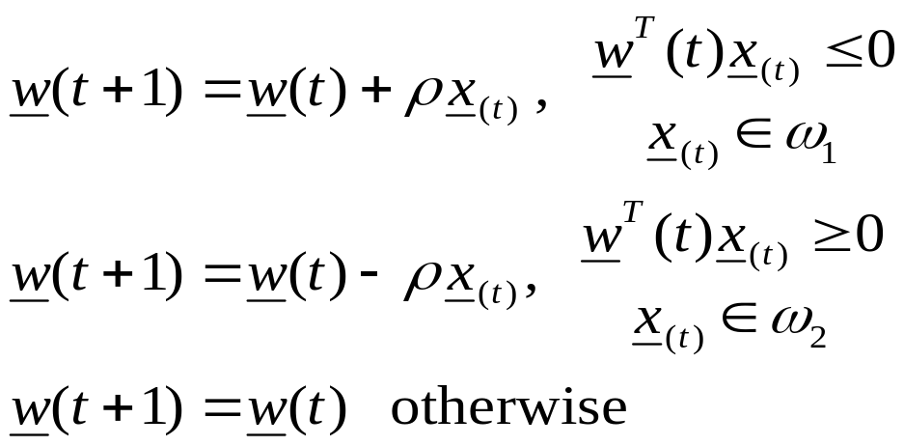
Variants of Perceptron Algorithm
  It is a reward and punishment type of algorithm

Slide 35
Variants of Perceptron Algorithm
initialize weight vector w(0)
define pocket w_{s}.and history h_{s}
generate next w(t+1). if it is better than w(t), store w(t+1) in w_{s} and change the h_{s}
  It is pocket algorithm

Slide 36
Generalization of Perceptron Algorithm for M- Class case

